Slide 1
Introduction to Concurrent and Parallel Systems
Dr Sergio Davies <sergio.davies@shu.ac.uk>
Department of computing
Sheffield Hallam University
30 September 2022
Notes:
Hello everyone,
My name is Sergio Davies and we will go together through this concurrent and parallel system module.
I am the module leader for this and I will be with you for the initial 12 weeks. Andrew Hamilton will cover the remaining 12 weeks.
But we’ll see the details of this in a moment

Slide 2
Welcome!
This module has been running for a while, and this is the first time in person after the pandemic.
If you have questions or feedback on the module, you can email both Sergio. Better to include both, so the first to pick up the email can reply.
If you rather post question or a comment anonymously, a form is always available: see blackboard / Student Voice / Anonymous feedback form, or use the link below https://forms.gle/xzMzDKn6wR545zYe7
Notes:
This module has been running for a while, but never in the current format. So I am sure there will be adjustments and changes in course, to adapt to this new way of teaching and learning. We’d love to hear from you questions and feedback.
In case you want to ask questions you can send emails to both of us, and the first one to pick it up will reply.
In case you prefer to submit a question anonymously, there is also a form which does not store information about yourself. During tutorial sessions we’ll look if there are questions, and in case we’ll look for an answer.

Slide 3
Module news
I will be leaving Sheffield Hallam University at the beginning of November;
I look forward to helping you for your assignment before then;
After that date, someone else will be taking over this module;

Slide 4
Module introduction
Module comprises two parts, one per term:
7 Weeks: Multithreading – Sergio (Module leader)
5 Weeks: TBD
All module based on C++: If you need to parallelise, means you need performance and therefore you need to write code as close as possible to the hardware. C++ is a good compromise and generally portable across architectures;
Two submissions:
End of first term: Submission on multithreads. Deadline will be in January. Weight: 60% of final mark.
End of year: Exam. Andy will discuss this in the second term. Weight: 40% of final mark.
Notes:
The module comprises two parts. During the initial twelve weeks, we will be covering multithreaded software.
During the second term, you will be covering CUDA with Andy.
We will use C++ during all the module.
This is because if you are looking to parallelise an algorithm, it means that you are struggling for performance. Therefore you need to write code as close to the hardware as possible to make it as fast as possible. There is no point in writing Java or Python code: these are languages compiled on a virtual machine or an interpreter which then require longer to be executed on the real machine.
In general C++ is a good compromise: this is a compiled language, so the executable is specific for one architecture, but the source code is portable across multiple architectures.
The module requires two submissions: one at the end of the first term, on multithreaded software. The second is the exam at the end of the year. The coursework is individual and will weight 60% of the final mark. The final exam will include also CUDA and will weight 40% of he final mark.

Slide 5
First term – Details
The lecture material will include some code examples which I will run and go through, to highlight the critical points of concurrency;
The code is available with the lecture, so it is highly recommended that you run the examples on your own and understand the issues at hand;
Every now and then I will open discussions during the lecture, or place you in subgroups. It is highly recommended that you actively participate, so to improve your understanding and make the session more interesting and fun.
Notes:
Now about this first term on multithreaded software.
The lecture material is already available. Through these recordings, and I will highlight critical points of concurrency.
I will show some code to highlight concurrency issues, and show some possible solutions.
For many of these issues there are multiple solutions. You are welcome to look and propose your own.
However, it is very important that you look at the code that I share. You need to run it, so that you understand what are these issues: these will be part of both the coursework and the final submission.

Slide 6
Some details (1/2)
Each lecture will conclude with a guide for the tutorial session so that you can practice coding with threads
It is recommended that you try writing the code on your own, before reading the solution that I will provide
The coursework will be based on the topics covered during these lectures: each lecture will introduce something new that will be part of the submission that you need to write.
The coursework will be individual and includes both code and a report
Notes:
Each lecture will then conclude with a guide for the tutorial session, to that you can practice coding with threads, following guidelines.
I will provide a problem so that you can write an algorithm to solve this.
I will also provide you with my own solution. However, as I said before, this will only be one solution, and you are encouraged to write your own algorithm.
In the first term the coursework will be based on all the topics covered during these lectures and tutorial sessions. Each lecture will introduce a new topic that will be part of the submissions. Both the coursework and the exam will be individual. The coursework will also include a report that you need to write

Slide 7
Some details (2/2)
During the module: workgroups! You can work in groups to help each other on practical exercises.
However, it is important that every member contributes to the group: the submissions will include individual code, results and a report, and they will be checked against other students to verify cases of plagiarism – suggestion: Don’t get caught!
In case of questions, you can try and address the questions in the group, then you can ask us in the appropriate ways.
Notes:
During the module you can work in groups, to help each other with practical exercises.
However it is very important that every member contributes to the group: the submission will include the individual code, results and a report, and they will be checked for plagiarism, so don’t get caught!
Please email us your group member names, so we can keep track. In case you have questions, you can start trying to address the question within the group, and contact us in case the question remains and cannot be easily answered.

Slide 8
Indicative content of the course
Concurrency – theoretical foundations
C++ – multithreading software development
Matrix multiplication algorithm
Producer/Consumer paradigm
Thread priority handling
Sharing resources
Avoiding deadlock and starvation
Thread locking
Condition variables
Concurrency patterns
Notes:
The module will cover the basic foundations of concurrency, and will cover the C++ tools to implement multithreaded software.
We will cover how resources are shared among threads and the main issues in parallel programming: deadlock and starvation.
Then will talk about how to correctly lock and unlock threads and use condition variables.
Finally we will explore some programming patterns for concurrency.

Slide 9
Teaching schedule
LECTURES |  | LABS
Date | Topic | Date | Topic
30 Sep | Introduction to concurrency Introduction to threads in C++ Mutex variables | 27 Sep | Practical example of parallel computing Simple matrix multiplication
7 Oct | Time analysis in multithreaded software Return values from threads | 4 Oct | Multithreaded matrix multiplication – 2 approaches
14 Oct | Condition Variables | 11 Oct | Evaluation of multi-threading speed-up
21 Oct | Concurrency patterns Producer/consumer | 18 Oct | std::async / std::future / std::promise experiments Dining philosophers problem
28 Oct | Thread pooling Thread prioritisation – R/W Locks | 25 Oct | Producer/consumer pattern – unidirectional and bidirectional communications
4 Nov | Coursework support | 1 Nov | Coursework support
11 Nov | Coursework support | 8 Nov | Coursework support
Notes:
This is a brief teaching schedule, still incomplete, as things will be updated as we go along, to adapt to these challenging times.
In case there are changes, I will notify you with announcements. Please read them (don’t automatically discard them!).

Slide 10
A little bit about yourself
How much experience do you have with C++?
How long have you been coding in C++?
Have you ever used multithreading functions in C++?
Notes:
To start, tell me something about yourself.

Slide 11
Topics
What is concurrency?
Why concurrency?
Notes:
Next few topics cover what is concurrency and why we use it

Slide 12
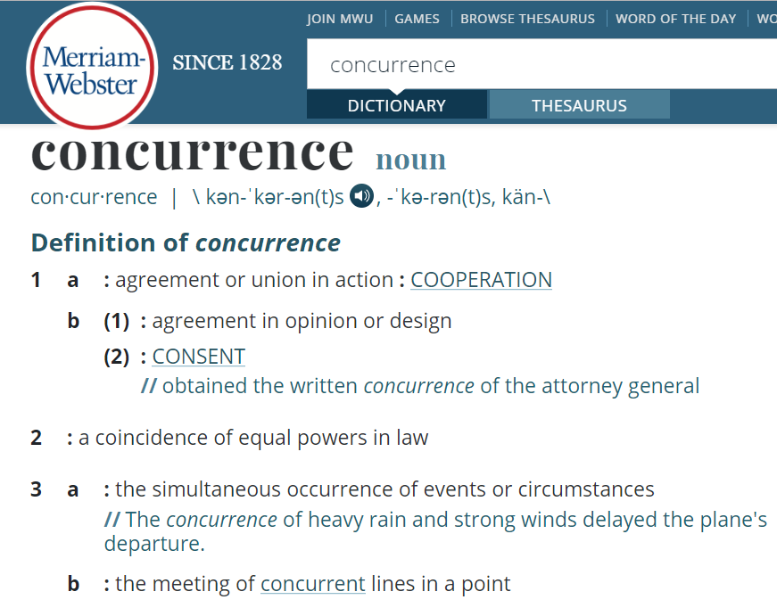
What is concurrency? (1/2)
Which of these definitions of concurrency do computer scientists use?
Notes:
So, let’s start with a basic definition: from the Merriam-Webster dictionary, which of these definition would you use as concurrency in computer science?
Pause the playback here, so you are able to read the definitions and come up with your answer.
You have guessed correctly with 3A: the simultaneous occurrence of events or circumstances.

Slide 13
What is concurrency? (2/2)
“Concurrent programming is the technique of writing programs that do more than one thing at a time” [Tom Axford – Concurrent programming: fundamental techniques for real-time and parallel software design – Wiley 1989]
In computer science, concurrency refers to the ability of different parts or units of a program, algorithm, or problem to be executed out-of-order or in partial order, without affecting the final outcome. [Wikipedia – Concurrency (computer science)]
[...] there is a separate execution point or thread of control for each computation (process). [Wikipedia – Concurrent computing]
Notes:
If we want to take a look at other three definitions

Slide 14
Concurrency – Takeaway message
In computer science,
Concurrency
is about computations that can
execute simultaneously,
and about how the
order of execution
affects the result.
Notes:
If we want to extract a common theme from all these definitions, in computer science concurrency is about computations that can excute simultaneously, and about how the order of execution affects the result.
Here, please note, the key point is on the “Order of execution”.

Slide 15
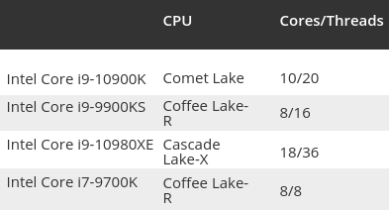
Concurrency in modern devices (1/2)
CPU Example: a set of modern CPUs for which the number of cores and threads is listed
[Tom’s Hardware – CPU Hierarchy URL: https://www.tomshardware.com/reviews/cpu-hierarchy,4312.html]
Notes:
Look at this set of modern CPUs: all of them have multiple core and threads: 10 cores, 20 threads or 8 cores 16 threads, and so on.

Slide 16

Concurrency in modern devices (2/2)
Mobile phone example:
Notes:
Now look at this mobile phone. It is a screenshot of an internet website that compares mobile phone. This is just one of them. Others aren’t much different from this. The key interest point is the CPU: why do you think there is the need for a mobile phone to have 8 cores in a single CPU?

Slide 17
Why?
Why do you think modern technology is going towards parallel computer architectures?
Group work
Discuss among your work group why technology is moving towards parallel architectures and why this cannot be achieved by single core architectures (5 minutes)
One representative for each group to bring your answer to the class
Notes:
So, modern technology is going towards parallel architectures, in workstations, supercomputers and mobile phones. Why do you think this is happening?

Slide 18
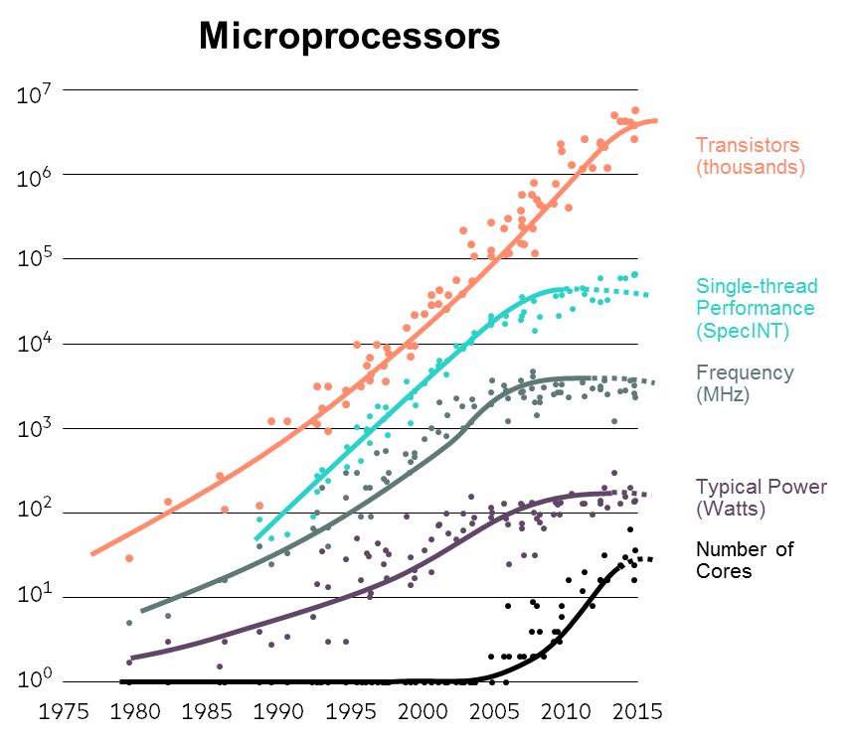
Why do we need concurrency? (1/2)
[Karl Rupp - 40 years of Microprocessor Trend Data]
Notes:
In this image you can see the evolution in summary of CPU technology:
The number of transistors follow Moore’s law: every 18 months the number of transistors in a CPU doubles.
However, we have had increase in performance up until the beginning of the millennium. After that the performance and the speed started becoming stationary: no more advancements were made because we hit limitations on the hardware.
Since we could not improve any longer the performance of a single core, we started increasing the number of cores, leaving to software designers to take advantage of the new CPU structure using software concurrency

Slide 19
Why do we need concurrency? (2/2)
Marginal improvements with processor speed are becoming smaller and smaller;
One of the limits is the amount of power being dissipated by each unit on a microprocessor;
Marginal improvements in performance with single execution thread are becoming smaller and smaller;
Trend in increasing the number of computational units (processors);
Notes:
See notes from previous slides

Slide 20
Topics - Summary
Real-life examples
Critical concurrency issues
Notes:
Let’s have some real-life examples of concurrency

Slide 21
Real-life examples of concurrency
Can you make an example in real life where concurrency naturally happens?
Group work
Discuss among your work group possible real-life examples of concurrency (3 minutes)
One representative for each group to bring your answer to the class
Notes:
Think about where concurrency would naturally happen in the real world.

Slide 22

Real-life examples (1/4)
Road traffic: each vehicle is an independent actor (process or thread)
Notes:
My favourite example in real life is the road: each car that is moving across the roads is an independent actor, or if we want to keep the similarities with computer science, each car is a process or a thread

Slide 23

Real-life examples (2/4)
System is only truly concurrent when there is more than one process or thread.
What if one of these processes misbehave (see image)?
Notes:
A system is truly concurrent only if there are more processes running at the same time in the system.
But what happens if one process misbehaves? If you see the image, you can see that one car is not following the rules. What do you think would happen?

Slide 24

Real-life examples (3/4)
Interactions between processes or threads can lead to crashes (if not treated carefully)
Notes:
Yes! A big car crash! In computer terms, this would mean system corruption.

Slide 25
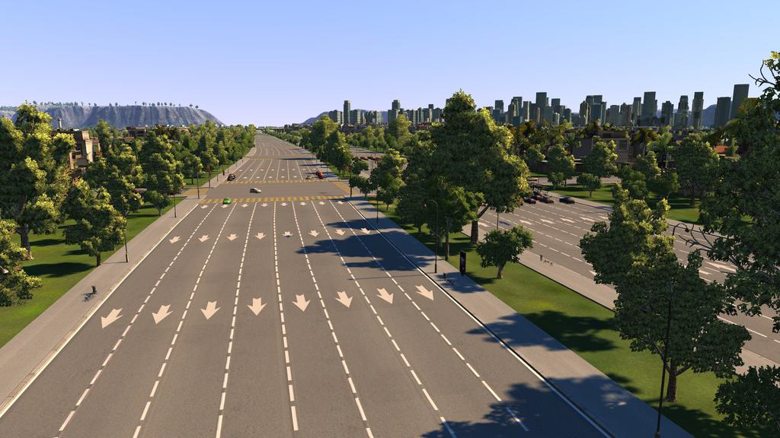
Real-life examples (4/4)
Many ways to handle process interactions
There are subtleties in correctly handling process interactions
Notes:
So it is important that we set rules for concurrent process to follow. In the image you see lanes where cars can run in a single direction: on the left coming towards you, on the right going away from you. However, at some points these roads will cross each other, and there is when things get interesting

Slide 26

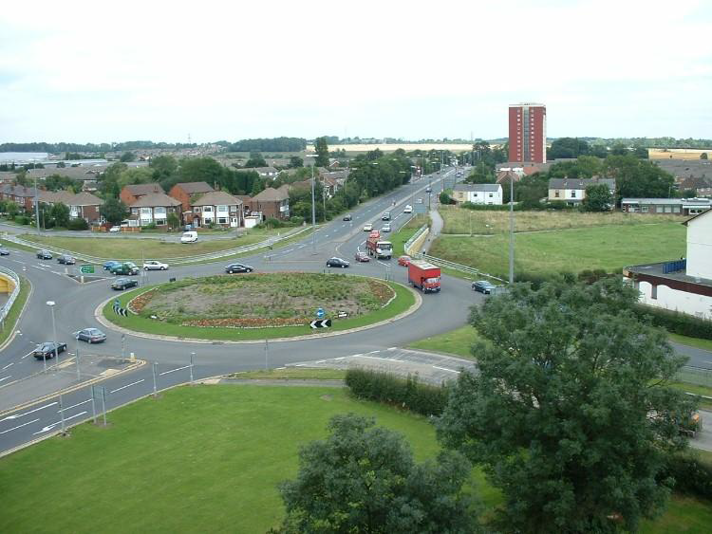

Real-life examples
Notes:
Things get interesting because it is important to define clear rules on how the process should interact with each other. On roads we have traffic lights in crossings, or we have roundabouts, or we have junctions

Slide 27
Critical concurrency issues (1/2)
Interaction of concurrent threads requires coordination:
Which threads can interact?
When can threads interact?
If multiple threads can, who goes first?
Concurrent coordination is not present in sequential algorithms.
Concurrent programming is more difficult than sequential programming because it requires making coordination explicit.
Concurrent coordination can lead to issues such as deadlock and starvation.
Concurrent programming is more difficult than sequential programming because it requires to be sure that code is safe (that is, free from deadlock and starvation).
Notes:
The interaction between multiple threads require careful thoughts: which threads can interact? When can threads interact? If multiple threads can interact, which one goes first?
This type of coordination is not present in sequential algorithms, and this is where the difficulty of concurrent programming comes it, because the interaction between threads is left to the software developer.
In general the two main issues while developing concurrent software are deadlock and starvation. Concurrent programming is more difficult than sequential programming because it requires to be sure that the code is safe in any possible case

Slide 28
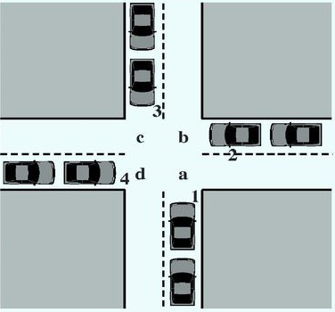
Critical concurrency issues (2/2)
Deadlock: is a state in which one thread is indefinitely waiting for some other thread to take action.
Starvation: occurs when a thread is perpetually denied necessary resources to progress.
Notes:
We talked about deadlock and starvation. But what are these?
Deadlock is a state in which each process or thread waits indefinitely for some other process or thread to take place.
Starvation, instead, occurs when a process is perpetually denied the resources necessary to progress its execution

Slide 29

Reference book
There are many books on C++ concurrency;
Principles described are always the same;
One reference may be: C++ concurrency in action : practical multithreading Williams, Anthony (Software engineer) 2012
Notes:
There are many reference books on C++ concurrency, and all cover the same topics.
If you have your favourite book, please use that.
Otherwise, this may give a good introduction: “C++ concurrency in action : practical
Multithreading” - Williams, Anthony (Software engineer) - 2012

Slide 30
Topics covered so far
What is concurrency?
Why concurrency?
Real-world examples
Critical concurrency issues
Notes:
Topics covered in this presentation:
- What is concurrency?
- Why do we need concurrency?
- A real-world example
- The two main critical concurrency issues

